Slide 1

WHY TRUCK BUSINESS IN BROAD SENSE ?
791,7
3,5
BLN USD
MLN
Total revenue of the
U.S trucking industry
(Sep’20)
of American freight
Is transported by
trucking industry
Total number of Truck
drivers in the U.S
(Apr’21)
Industry has higher
revenues than
Freight revenue
Is forecasted to
grow
Still industry
short
8OK
100 75%
Drivers
countries
by 2026
in the world

Slide 2
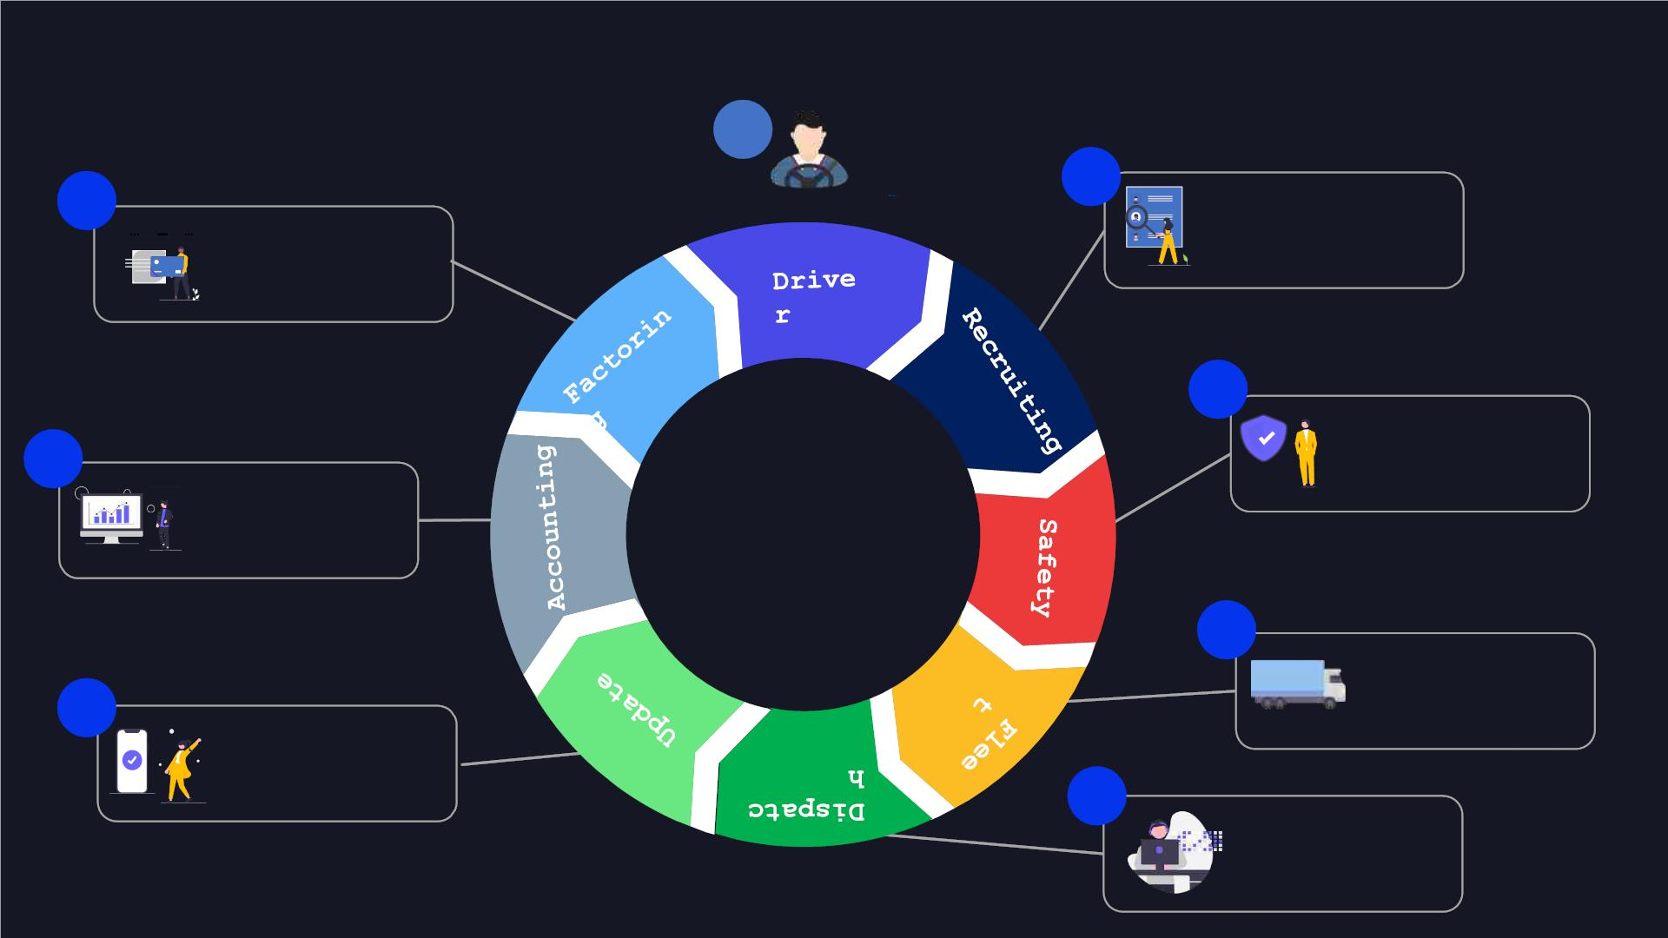
TRUCKING PROCESS
1
2
8
Checks driver , agrees on
conditions, (fees bonuses)
sign contract
Checks dos & makes
payment to company
3
Drug testing, add driver to
7
all insurance & permits.
Prepare folder with
documents
Checks bill of lading
and docs . Enter info to
TMS.
4
Ensure truck is ready
to be driven , clean ,
6
Update broker on the
location of load, current
status, & delivery. Help
driver in any case on road.
5
Find out load, negotiate
with broker, deals with
driver. Gets rate
confirmation.

Slide 3

Recruting
1
Searching for best
fit drivers
4
Work with approved
drivers
5
Work with hired
drivers
Through Facebook
- Mini orientation &
acquaintance with charges
bonuses
- Call & send messages
at least once a week
Through Referrals from
other drivers
- Creating TG group
- Try to help drivers to
solve any company related
issues
- Inform driver if there
are any changes in terms
of agreement
Cold calling from database
- Inform other departments
about driver
Driver approved
2
Sort out interested
candidates
3
Finishing
application
If complies with Safety
Check if driver fits our
requirements
Get CDL
Send application make them
fill it
Check violations &
accidents
Deal on conditions
Keep in touch with driver
while safety check

Slide 4

Safety
Compliance with
regulatory
requirements
Federal Motor
Carrier
1
Safety
Administration
2 Transportation
safety
Monitor Driver/Vehicle examinations
reports, review the decisions
regarding penalties/rewards,
warnings, terminations.
Reviewing MVR and PSP of new
3 Other
applicants, selecting good
candidates for potential
drivers.
Works with necessary documents
Add/removal of drivers/endorsements,
applications for new policies.
Driver check &
tests
Trainings for new drivers
Quarterly IFTA, reports for NM, KY, NY.
Monthly OR reports.
Work on accidents :
Monitor safety-related portals, e-
mails, mail.
Reviewing / Opening / Monitoring
Claims
All insurance related tasks :
Working on internal / external
audits
Correct Documentation
Monitoring payments

Slide 5

Fleet department
TRUCKS
SERVICE
Searching for available
trucks
Scheduling regular truck maintenance
Prevented maintenance services
Annual inspections
Providing necessary materials to
truck :
Devices
Stickers
Documentation and etc
Maintaining strong relationship
with truck rental companies
Maintaining detailed records of vehicle
servicing and inspection
Status of current trucks
servicing
Database for previous serviced
trucks
Orientation and assistance for new
starter drivers
Ensuring strict servicing and
maintenance (Truck breakdowns)
Proper management of driver
termination process
Effective interaction with other
departments
Monitoring Trucks information sheet

Slide 6

Dispatch –
1
Analyze the market
Check out the market
condition
Analyze which load better to
Help the driver to get best appointment for the
load according to the wish of the driver and make
sure driver is in safe.
book
Check out which state is
better to book load
Make sure each driver (L/C) or team reach a
weekly gross/ rpm goal set by management
Make sure the load paying is
more than average market rate
Provide good service to customers – brokers,
build strong business relationships with them
Responsible for good communication with
safety/fleet departments make sure drivers follow
their instructions (drug tests, PM service apps,
etc.)
2
Book load
3 Finalize
Book through Loadboards or
directly from brokers
Update other
departments regarding
the load
Check all details : load appt,
weight, commodity, special
requirements
Get Rate confirmation , sign it
and dispatch driver according
to it.
Dispatch driver till
delivery
Start looking next load

Slide 7
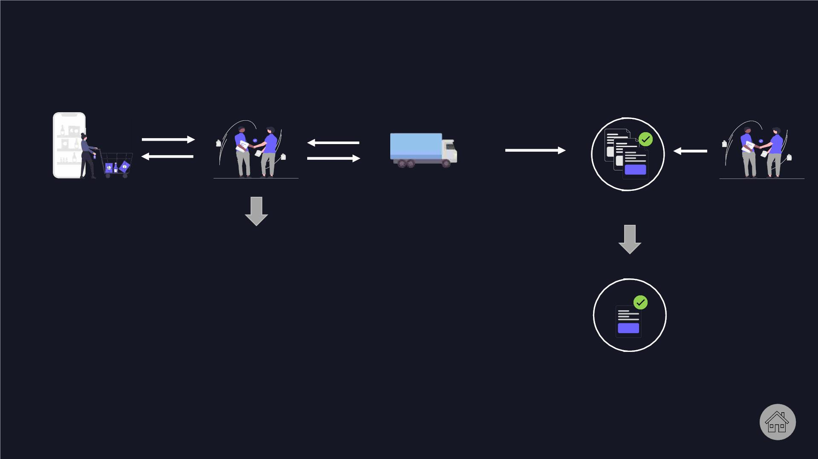
Broker
Customer
Broker
Carrier
company (we)
Set up
agreement
Broker
For each
load
They use their connections with carriers to help
shippers get their loads covered at better prices
that most shippers have the power to negotiate
§ They earn a commission on each load they ‘sell’,
schedule, and see through to delivery.
§ Their earnings come from ‘selling’ loads to carriers
for less than shippers are willing to pay, ideally
covering expenses and netting them a profit.
Rate
confirmation
paper is
signed

Slide 8

Update department
Main responsibilities of update department
includes :
Update brokers about drivers’ location,
arrivals/departures to/from the stops and
issues drivers having on stops and in-
transit
Make sure drivers are arriving to all stops
on time
Resolve all issues drivers are having on
time
Provide with written and verbal follow-ups
for the next shift about issues happened
with drivers.
Respond to all brokers’ and drivers’
messages on time

Slide 9

Accounting
Ensuring correctness of the necessary paperwork
for invoices (rate, customer, carrier);
Checking all invoices for correctness with the
person who made the payment;
Collecting all original paperwork, keeping records
of mail received from drivers, sending weekly
reminders to drivers;
Preparing invoices for factoring and sending
direct invoices to carriers daily;
Maintaining QuickBooks for company, monitoring all
payments made from company's bank account and
collecting paperwork for every transaction;

Slide 10
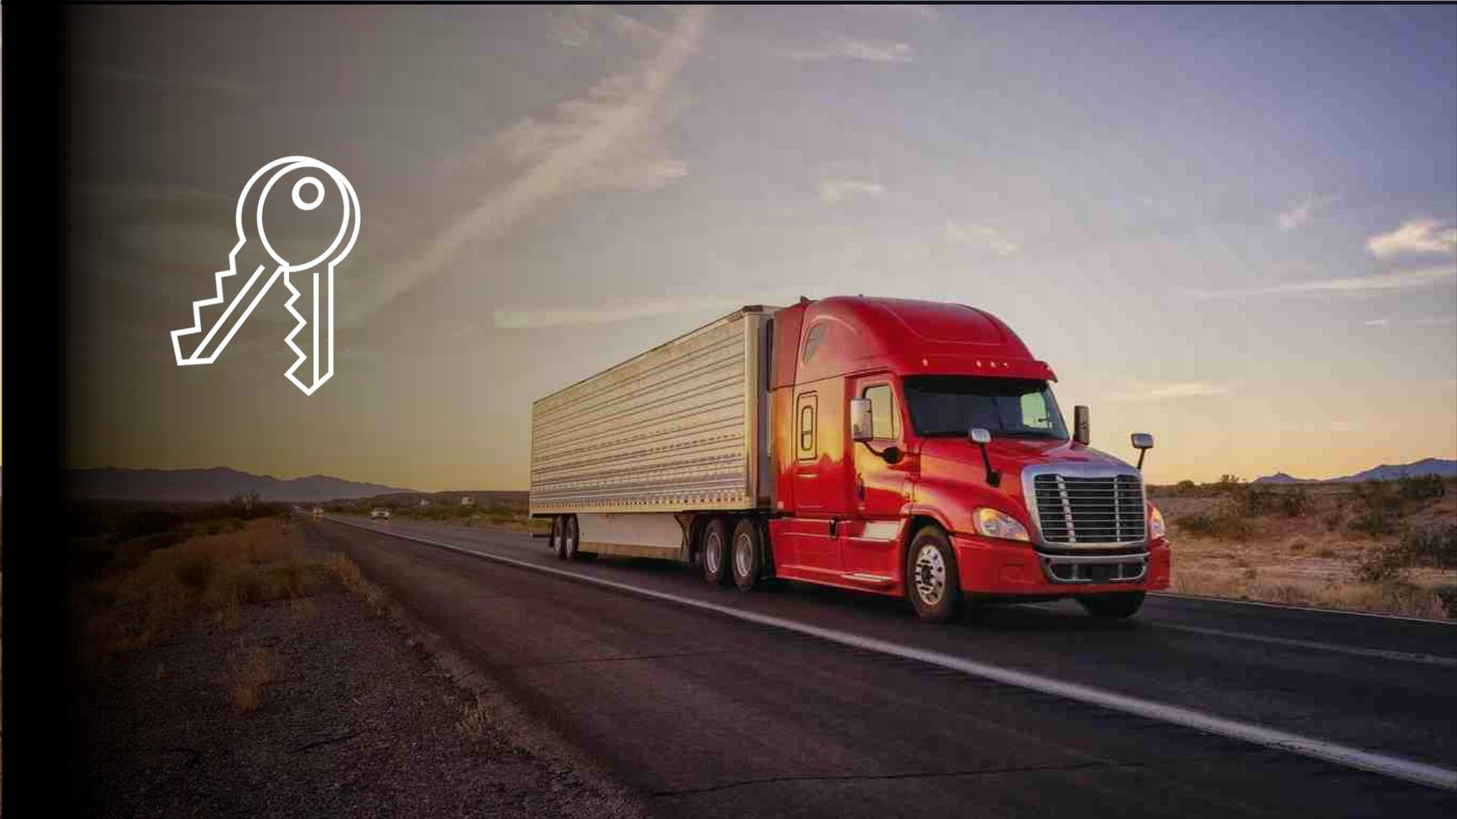
TURNKEY
OFFER

Slide 11

What we are offering
?
100% ready company with all necessary attributes for successful company
Dispatch
Safety &
Recruiting
Trainings &
Orientation
Fleet
Back office
set up &
Accounting
professional
personal

Slide 12
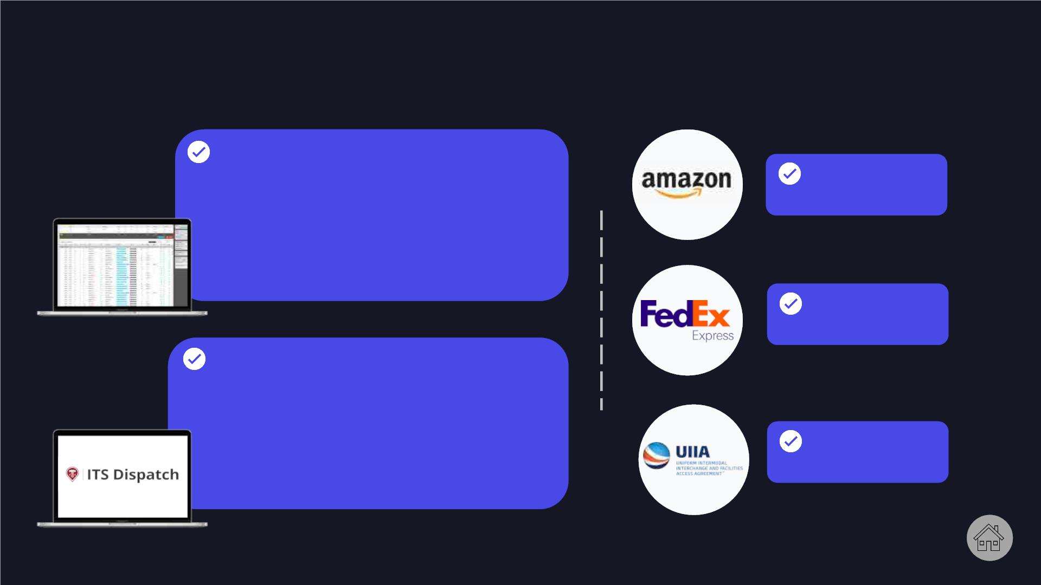
Dispatch
LOADBOARDS SET UP
Loadboard is used to take loads, brokers
upload any updated new loads, and dispatchers
may see and contact brokers, get loads from
them
AMAZON
ACCOUNT
DAT LOADBOARD
AMZ LOADBOARD
COYOTE LOADBOARD and etc
FEDEX
ACCOUNT
TMS SET UP
ITS Dispatch is a complete transportation
management system (TMS) designed to help
to keep trucking business organized, it is
kind of CRM system, but for the whole
trucking business, starting from flee
ending with accounting. Easy to monitor
fleet size, details of all loads, easy for
the accounting to monitor credit/debit.
UIIA RAIL
ACCESS

Slide 13
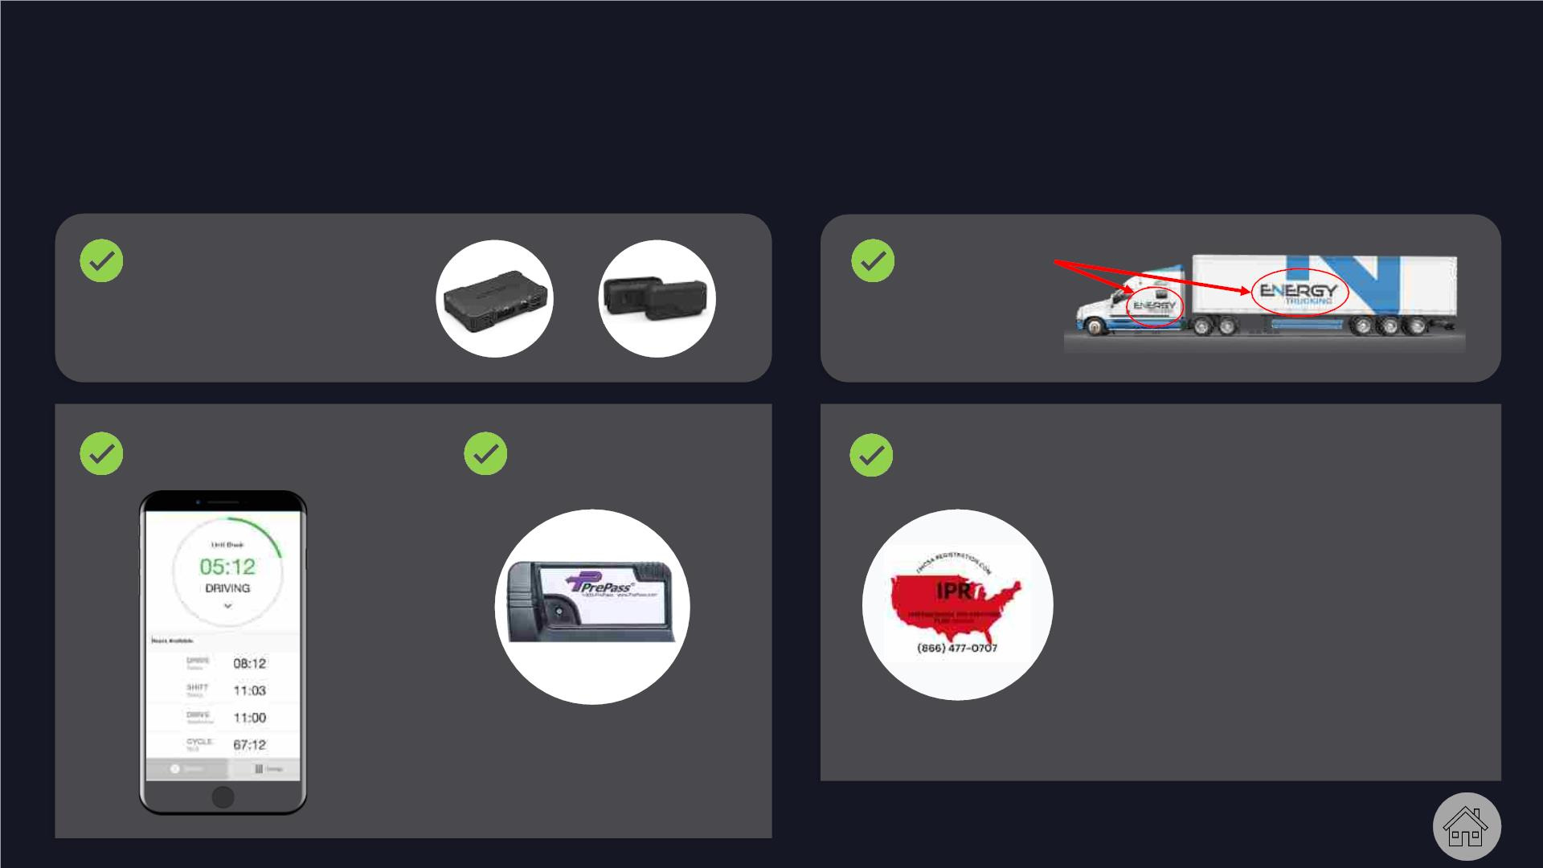
Fleet
PREPARE MUST HAVE ATTRIBUTES FOR TRUCK
INSTALL
PREPARE
GPS & CAMERAs
STICKERS
SET UP ELD
PREPASS
/ELITEPASS
ESTABLISH IRP ACCOUNT
The main purpose of the
International Registration
Plan is to promote interstate
commerce. It encourages the
fullest possible use of the
highway system. It allows
registered motor carriers to
travel through all IRP member
jurisdictions.
Technologically-
advanced weigh station
bypass platform

Slide 14
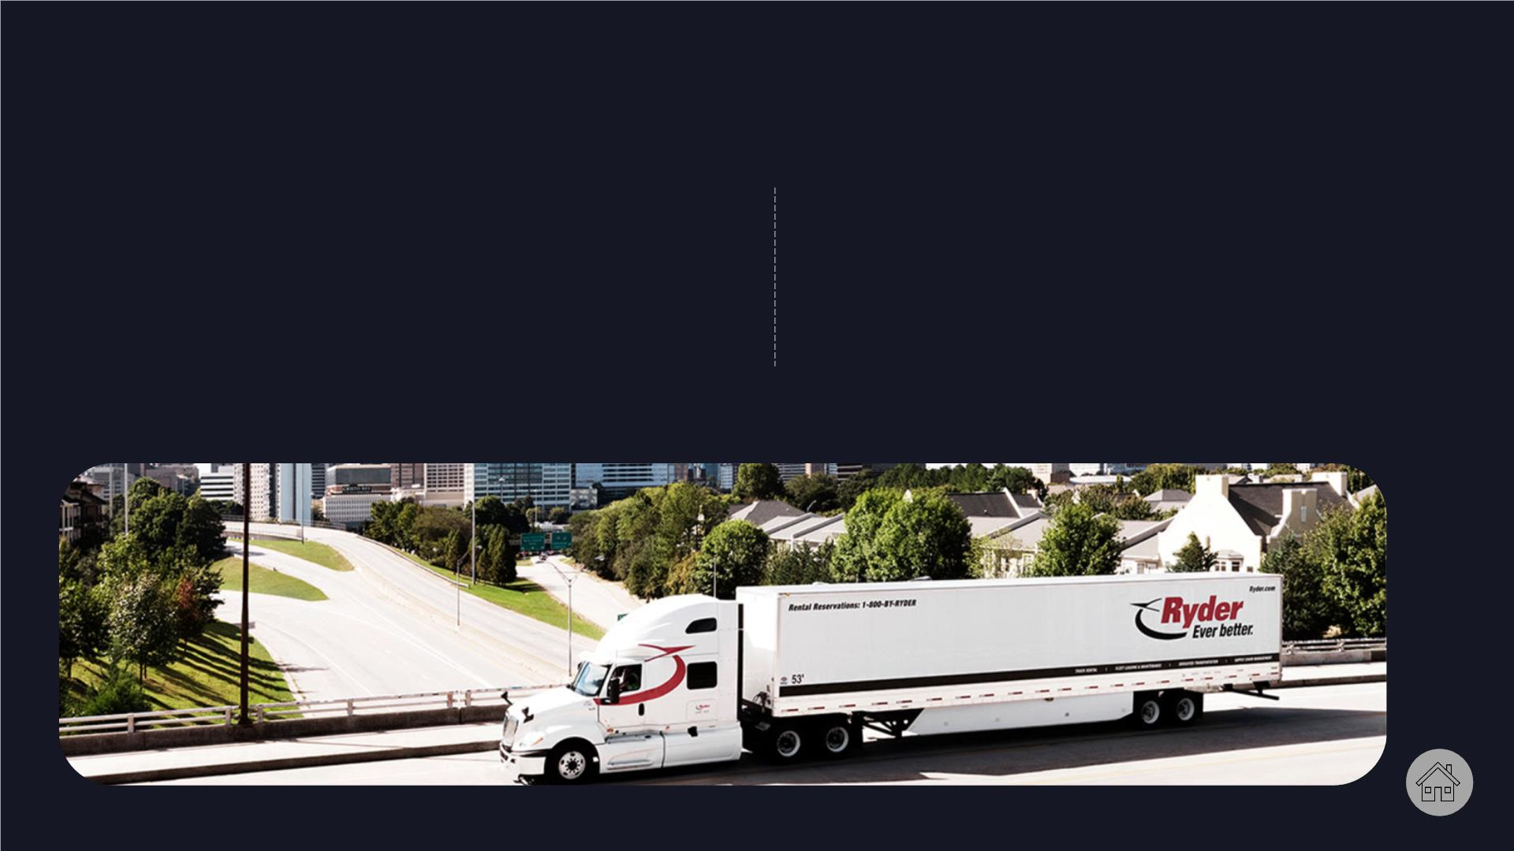
Fleet
One of our advantages, help We will also help in
in opening a Ryder account, hiring
5 drivers for the
as well as in renting 5
trucks from Ryder and
company :
Solo lease/solo
owner/team lease/team
company.
Penske companies

Slide 15

Recruiting
ESTABLISH STRONG BRAND IN SOCIAL MEDIA PAGES FOR RECRUTING DRIVERS
We will set up all the
necessary accounts in
social networks :
- Instagram account
- FB account
Set up
- corporate mail-
- create a website and logo
for company

Slide 16

Safety
Register company in Ohio
Will help to get
expensive orders from
broker & get insurance
much cheaper
Provide client with vetted Active MC / DOT
account
Verified active trucking businesses with clean record and
experience
We make sure that MC successfully passed the entrance
audit
We will establish a full-fledged safety business system, taking
into account all the standards of the American federal
administration.
Set up safety insurance and help to get it at best price

Slide 17

Safety
Establish the correct collection of files of drivers, contracts between the
company and drivers (safety documentation and contracts are drawn up by a
lawyer with 20 years of experience in the field of cargo transportation),
DRUG &
ALCOHOL
CLEARING
HOUSE
Put in place drug testing account & procedures -> clearing house
Set up Tenstreet software that connects drivers &
carriers
SAMBA SAFETY
Continuous driver monitoring will help company & protect it from risky
drivers, while saving time and money

Slide 18
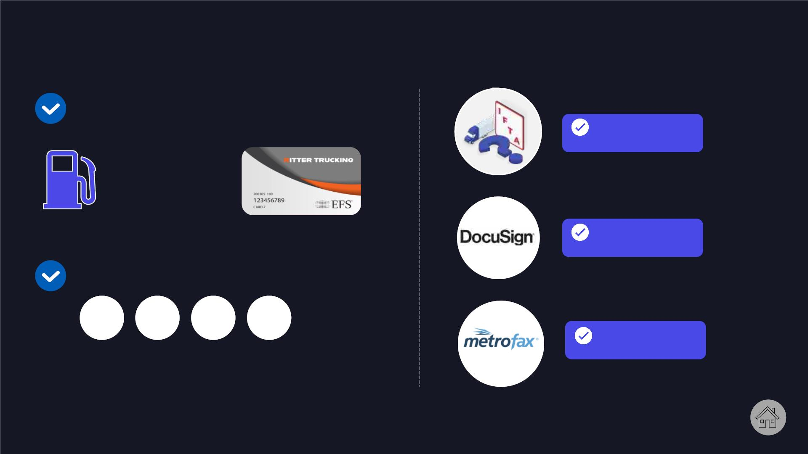
Safety
We will help in obtaining
discounts with fuel cards from our
partners;
IFTA
LICENSE
SAVE UP TO
70 C
PER GALLON
DOCUSIGN
ACCOUNT
Help to get all federal
permits
NY KY NM PA
METROFAX
ACCOUNT
There are four states that require
trucking companies to pay additional
weight distance taxes to haul within
their state lines

Slide 19

Accounting
Our company will help you in
opening bank account &
establishing factoring
company
We will establish
Quickbooks account and
install the system
accounting for ready
business

Slide 20

Office set up
Office set up in
Uzbekistan
Overseas professional
office setup
Office rental, Phone number
installation , fax, Ip
phone connection,
Office registration, Phone
number installation , fax,
Ip phone connection,
establishing mail forward
service
Set up new phone
numbers and fax for
business & corporate
mail & workplace for
employees

Slide 21

People
Your company will have a team of highly experienced specialists
Dispatch
Recruiting
Fleet
Safety
Accounting
Maintain great
relationships
with broker &
drivers, get
best loads
Hire & retain
best drivers
Search for
trucks & keep
them running
Search for
trucks & keep
them running
Receivable,
payable,
bookkeeping

Slide 22

Immigration to USA
Help and immigration
support in relocating to
the US for starting and
running a trucking
business – an easy path to
the US Green Card
There is real chance of getting E-2 & L
-1 visas
The process takes 1,5 - 2
months.

Slide 23

Orientation week
Step by step induction with each department
Detailed glance at real working process of each department
2 days
1 day
1 day
1 day
Dispatch &
Update
Fleet
Safety
Recruiting
Info about type of trucks
Type of loads
Type of load bases, DAT
Amazon
Info about brokers
TMS system
Spreadsheet observing
Step by step guide
Process from searching
truck to assigning to
truck to driver
Safety job description
Driver checking process
Driver hiring process
Step by step guide
Communication with
drivers
Type of services
Monitoring company’s
compliance with
regulation
Devices , ELD & etc
Searching technics

Slide 24
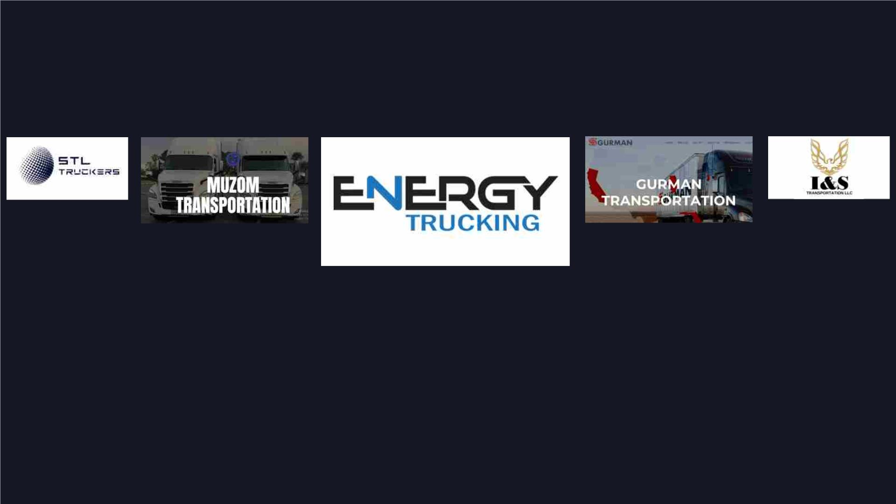
UZB companies that made it big !
Established : 2020
Quantity of trucks :
200

Slide 25
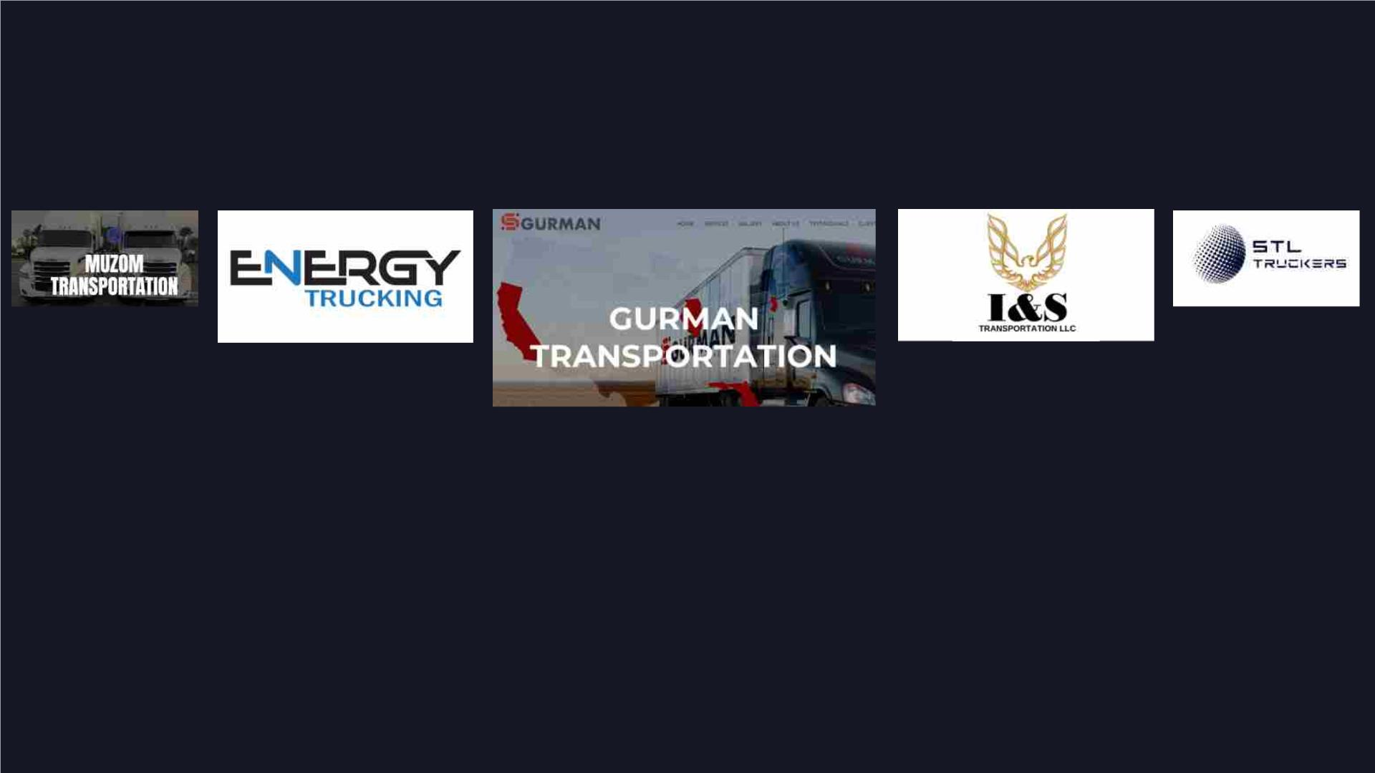
UZB companies that made it big !
Established : 2018
Quantity of trucks :
250

Slide 26
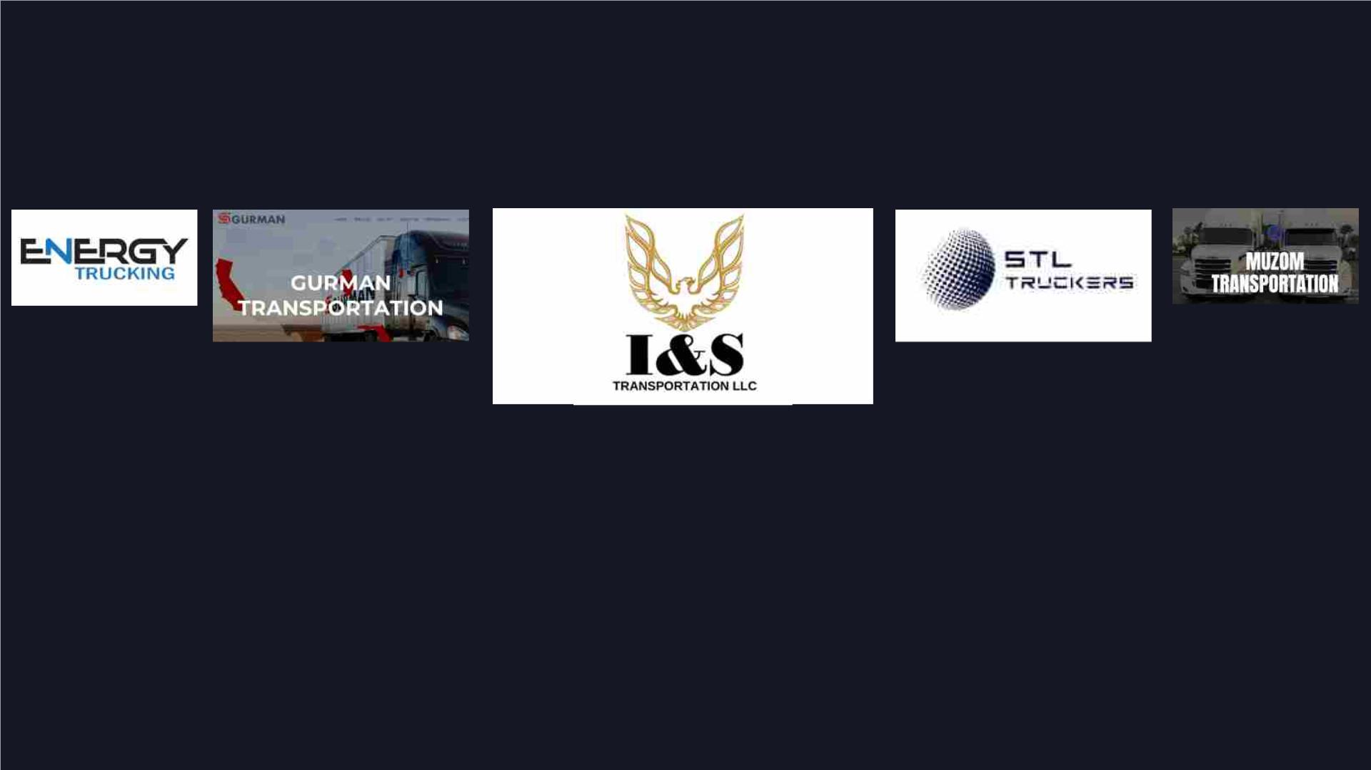
UZB companies that made it big !
Established : 2017
Quantity of trucks :
133

Slide 27
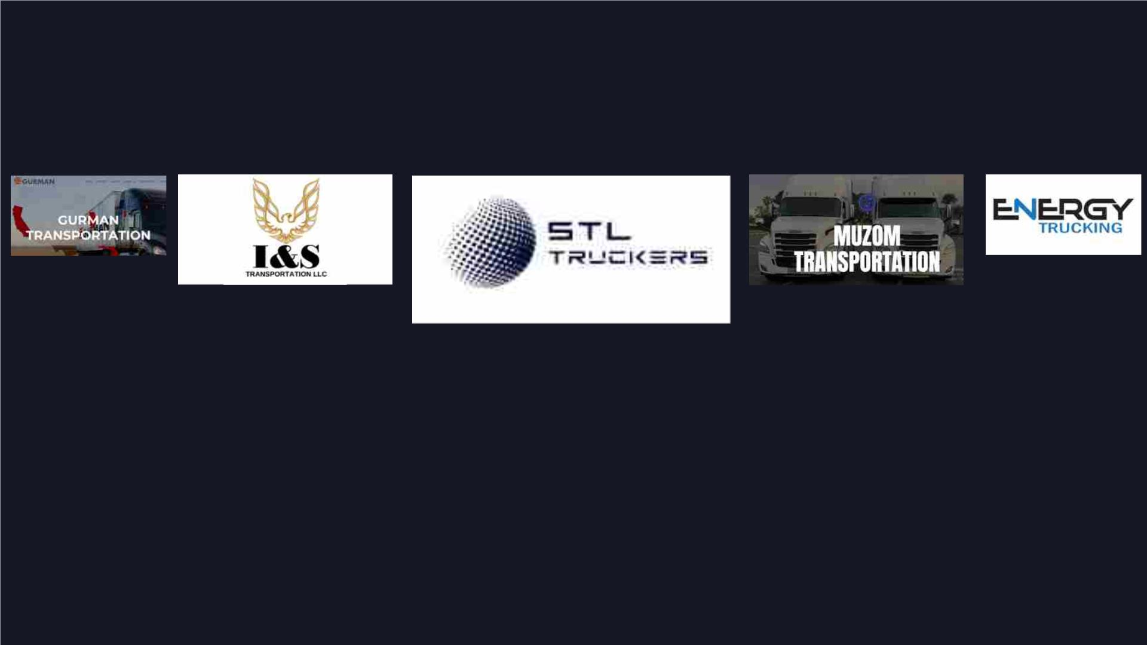
UZB companies that made it big !
Established : 2014
Quantity of trucks :
460

Slide 28
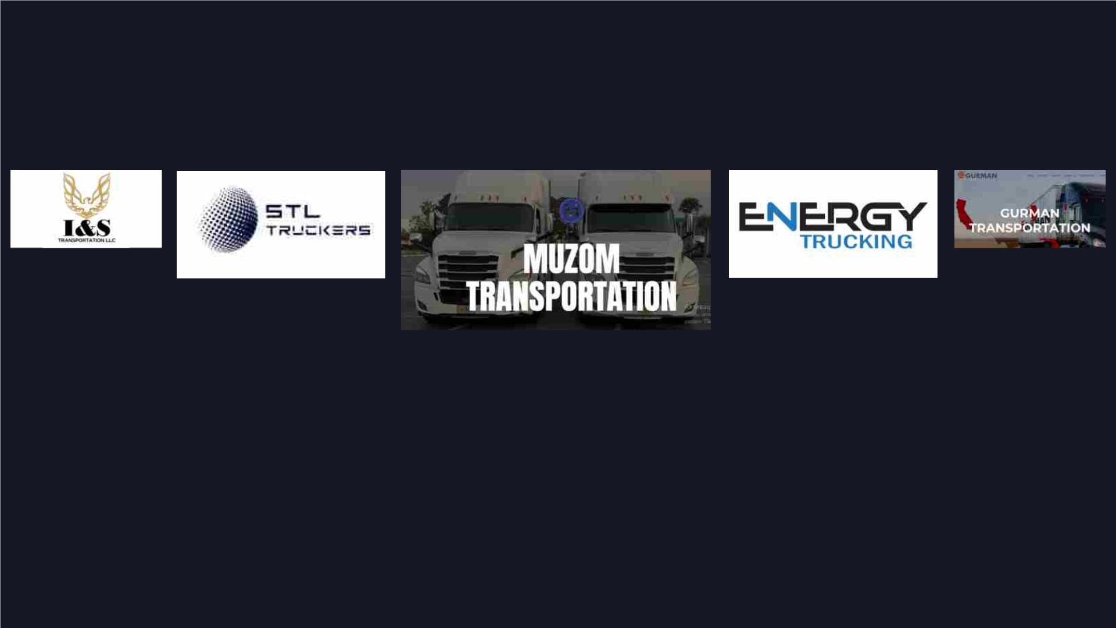
UZB companies that made it big !
Established : 2014
Quantity of trucks :
200

Slide 29
SO YOU WILL GET 100% READY COMPANY WITH ALL NECESSARY
ATTRIBUTES FOR SUCCESSFUL TRUCKING COMPANY !
Dispatch
Safety &
Recruiting
Trainings &
Orientation
Fleet
Back office
set up &
Accounting
professional
personal

